Slide 1



WinWork
Human Computer Interaction 2018/2019
REALIZED AND PRESENTED BY
Leonardo Salvucci

Slide 2

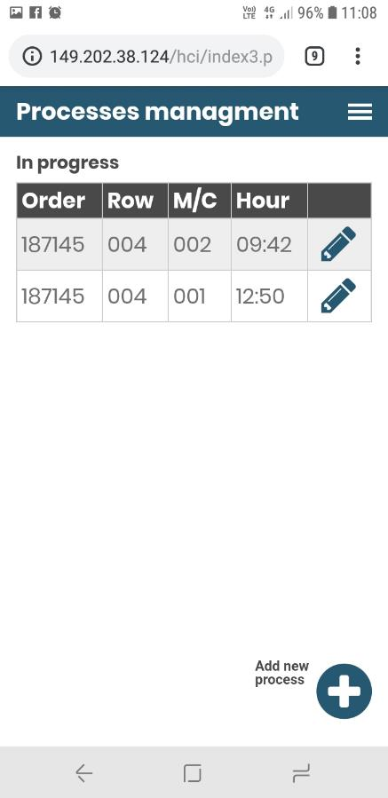
What is WinWork?

Slide 3
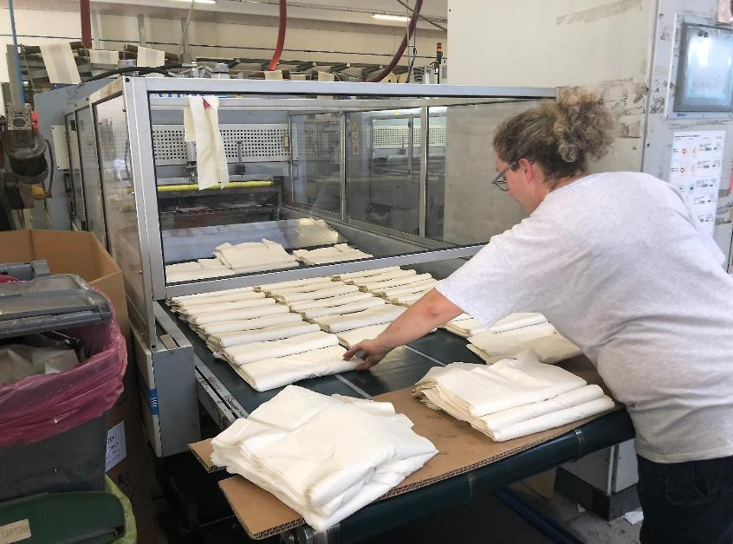
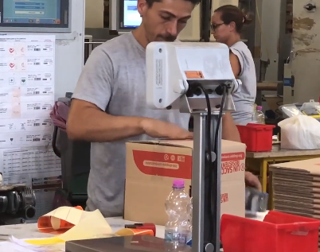
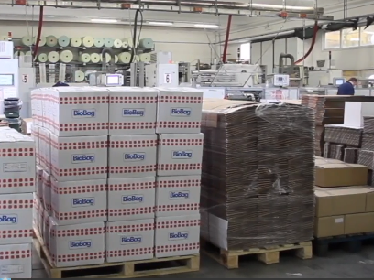
What WinWork does?
Withdrawal
Weight & Canning
Placement

Slide 4

User profile
Scenario
It’s 5.00 pm on Monday, Daniele is been working for many consecutive hours, moving to the various sections of the company. He is monitoring several production processes but he doesn’t remember them. So, he opens WinWork and checks easily the machines that he must monitor, optimizing the time and reducing errors.
Persona
Daniele is 23 years old, he has a diploma and he really wants to work. He delivered the pizzas for three years, but he wanted a more interesting job. He has been working in the company for a few months and he is very fascinated by his work.

Slide 5

User profile
Scenario
It is 6.00 pm, after many hours of work, Giovanni isn't mentally lucid. He is putting the boxes on the '0129' platform, there are already many boxes on the platform and he has difficulty counting and adding the new boxes. So, he uses the application and he can view the number of boxes already placed and he can easily increase the number with a special button, minimizing the use of short memory.
Persona
Giovanni is 56 years old, he is a veteran of the company. He will retire in a few years, but he still wants to work. He is a reference point for everyone in the company and he is very friendly to everyone.

Slide 6

User profile
Scenario
It is 5.30 pm, Luca is very tired but he has to work. Furthermore, the machine '004' has crashed and he is very stressed because he must monitor the other processes. Thus, he opens WinWork and sends a message to the manager notifying him of the problem, being able to continue monitoring the other processes, optimizing the times.
Persona
Luca is 35 years old, he has worked for several years in the company and he is no longer impressed by the job, but he has a family and he has to work. He would like to change jobs, but he is paid well and he stays in the company.

Slide 7
Questionnaires

Slide 8
Questionnaires

Slide 9
Questionnaires

Slide 10
Interviews
What problems do you encounter when you write data with the paper method?
When I do a survey, I have to write the number of the survey, the hour and finally the weight value, so I spend a lot of time and I can make errors. In addition, when I have to update a value, I have to remember the last value and perform the sum, so I can make errors.
Conclusion
Minimize the data that an agent must write, minimizing also the use of short memory

Slide 11
Interviews
What problems do you encounter when you change production processes with the paper method?
If I forgot the papers related to a process in each location of the machine, I don’t remember the machines that I’m monitoring. In addition, if I have all papers with me in each machine, I have a lot of papers and it’s more difficult to manage all of them, increasing errors and time of work.
Conclusion
The agent must always know the processes that he is monitoring and he must be able to change them easily

Slide 12
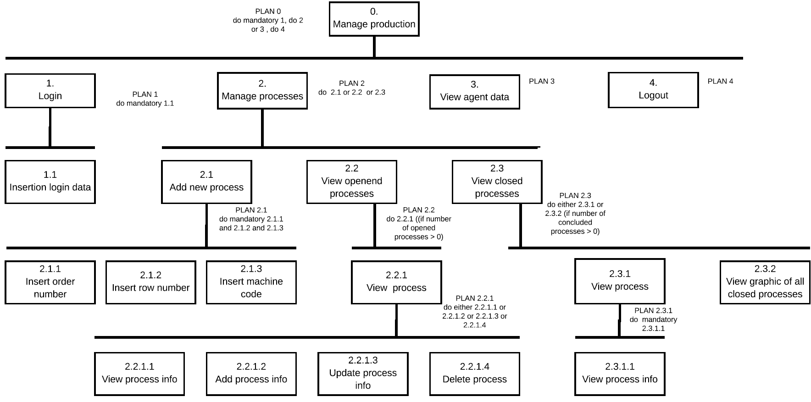
1° prototype - HTA

Slide 13
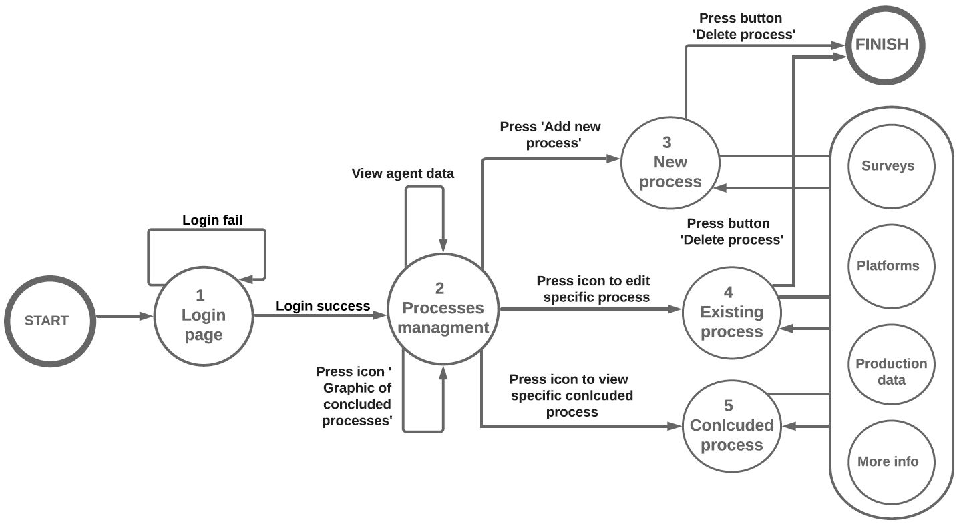
1° prototype - STN
System feedback
#1 Show error message
#2 Go to the landing page
#3 Show agent data
#4 Open popup to view the graphic of concluded processes
#5 Go to the new process page
#6 Go to the existing process page #7 Go to the specific concluded process page
#8 View Surveys or Platforms or More info or Production data
#9 Delete process
9
9
5
8
3
1
Reachability
1: 2
2: 1, 3, 4, 5
3: 1, 2
4: 1, 2
5: 1, 2
8
2
6
4
8
7

Slide 14
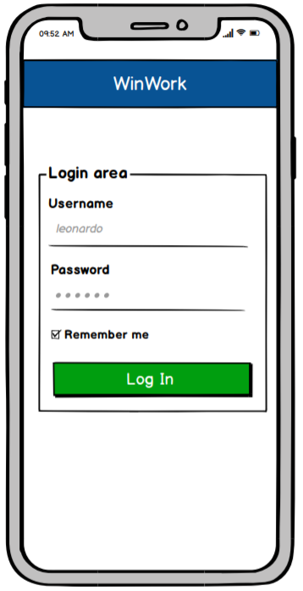
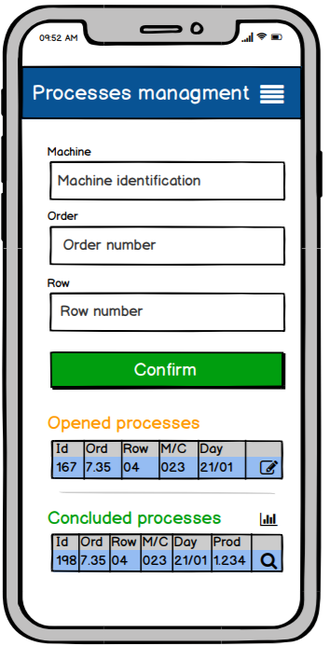
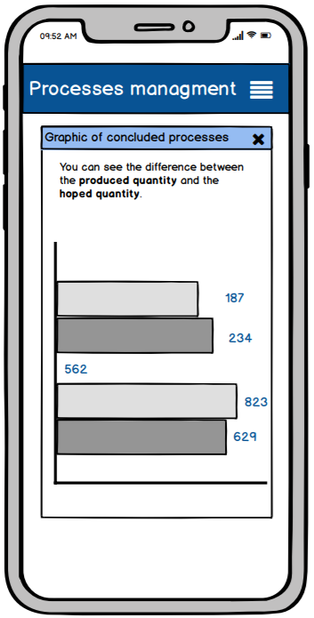
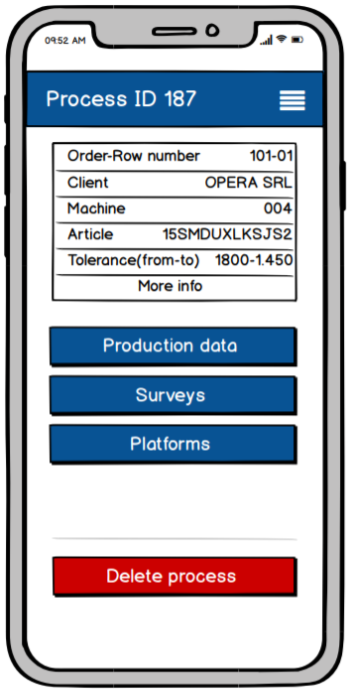
1° prototype - Mockups

Slide 15
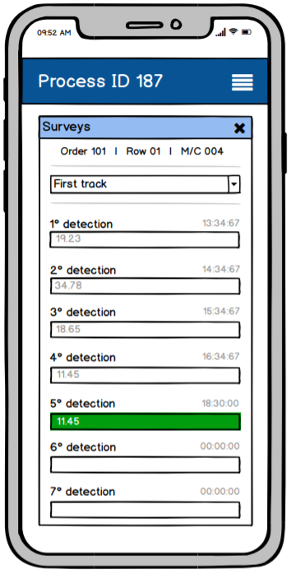
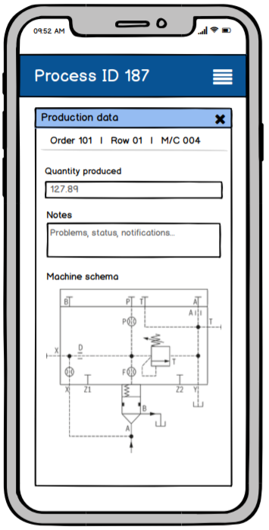
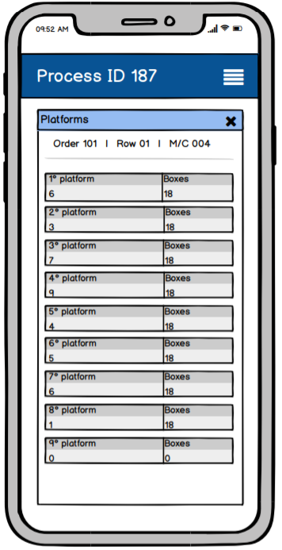
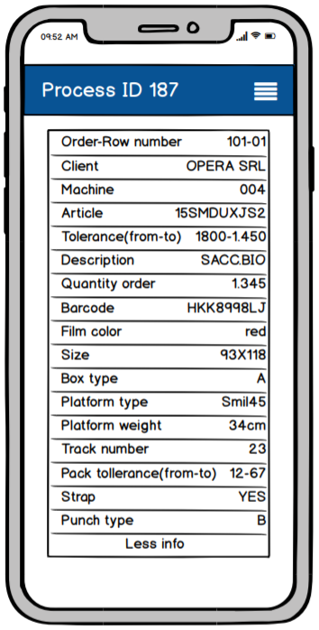
1° prototype - Mockups

Slide 16
Heuristic Evaluation
Page | Heuristic violated | Severity | Description
Login page | Recognition rather than recall | 2 | If the username is the employee id number think about replace «username» with «employee number»
Login page | Recognition rather than recall | 2 | Supply a brief indication on how to recover in case of forgotten password
All | Help and documentation | 3 | Introduce a brief help in order to illustrate the application. A glossary with the sued terms (machine, order, row…) could be useful
Graphic | Recognition rather than recall | 3 | It will be useful to indicate the information on the axis and the bars
Process | Visibility of system status |  | «Process id 187» is on several different pages with different data

Slide 17
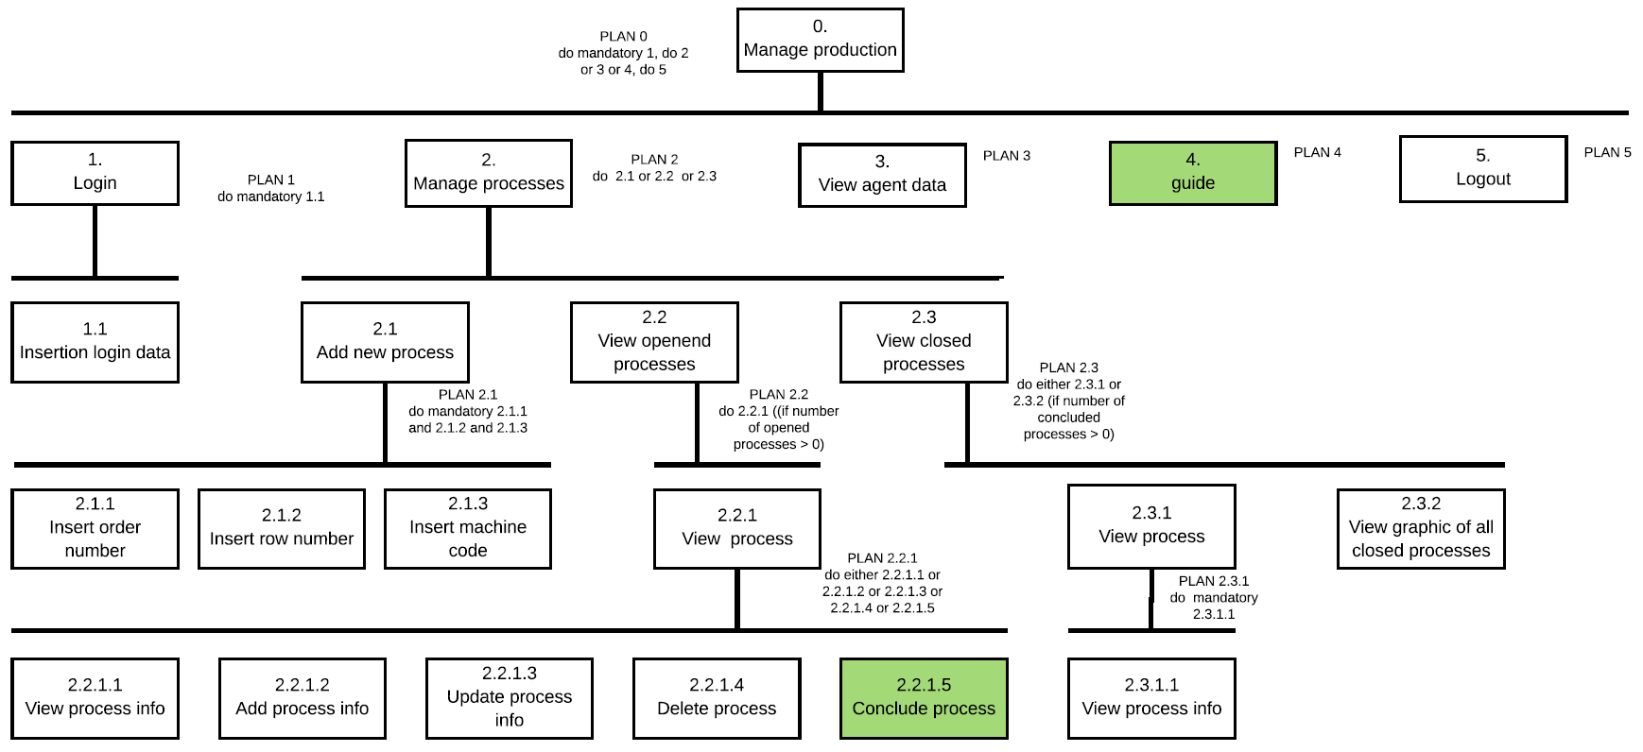
2° prototype - HTA

Slide 18
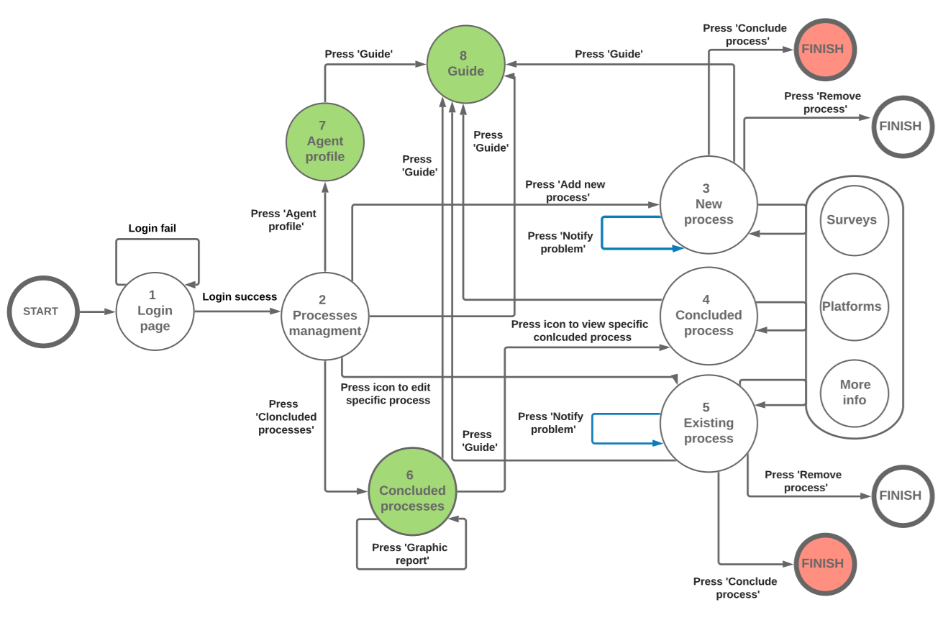
2° prototype - STN
System feedback
#1 Show error message
#2 Go to the landing page
#3 Go to the concluded processes page
#4 Go to the personal profile page
#5 Go to the guide page
#6 Go to the specific concluded process page
#7 Open Surveys or Platforms or More info
#8 Go to the new process page
#9 Go to the existing process page
#10 Send message
#11 View Graphic report of concluded processes
#12 Delete process
#13 Conclude process
13
5
5
12
5
click
4
8
7
10
1
click
2
7
9
6
click
7
Reachability
1: 2
2: 1, 3, 5, 6, 7, 8
3: 1, 2, 6, 7, 8
4: 1, 2, 6, 7, 8
5: 1, 2, 6, 7, 8
6: 1, 2, 5, 7, 8
7: 1, 2, 6, 8
8: 1, 2, 6, 7
3
10
5
12
13
11

Slide 19
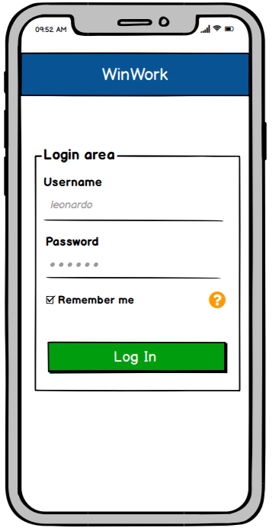
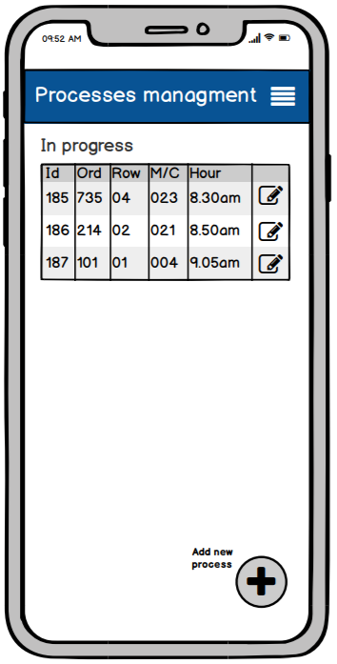
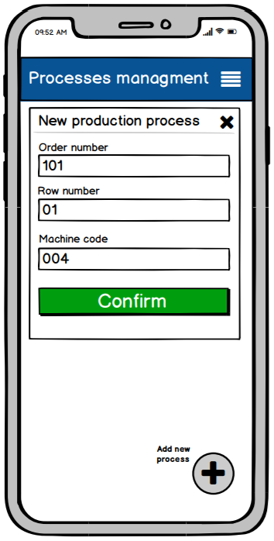
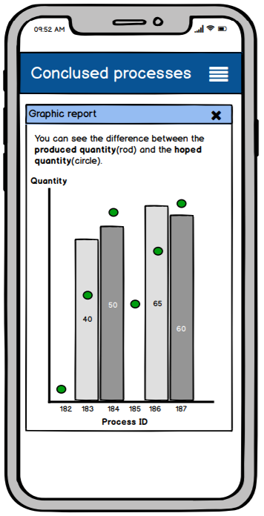
2° prototype - Mockups

Slide 20
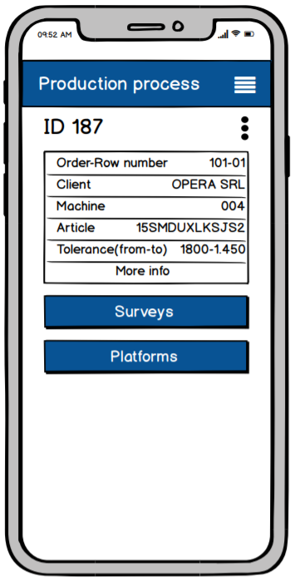
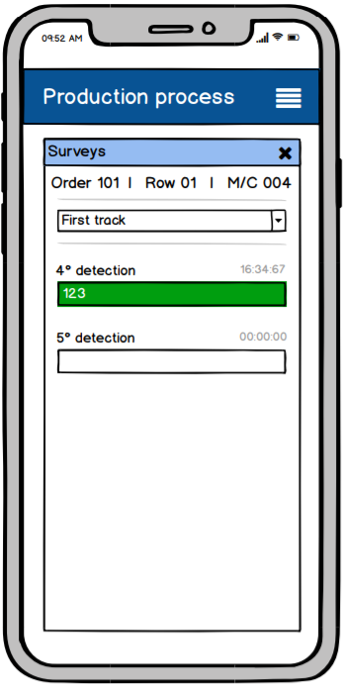
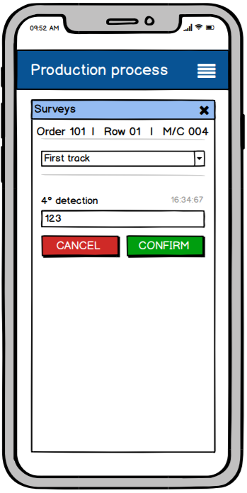
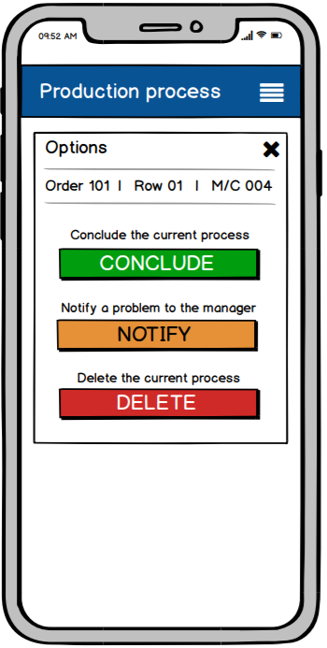
2° prototype - Mockups

Slide 21
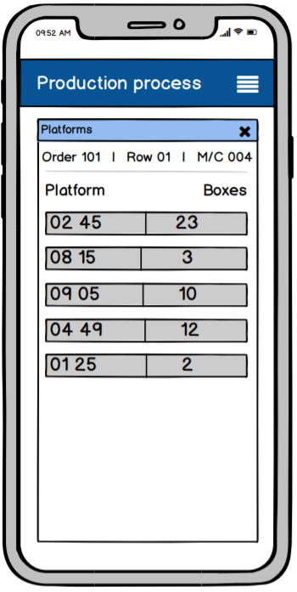
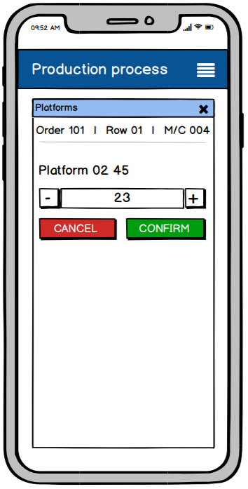
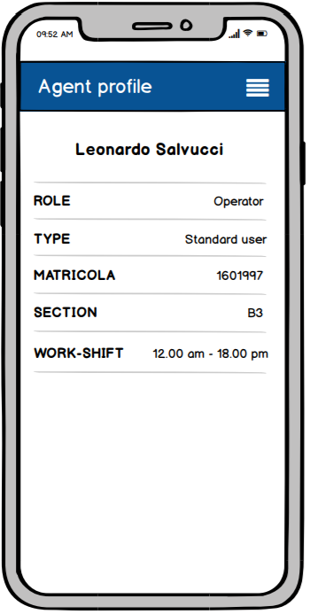
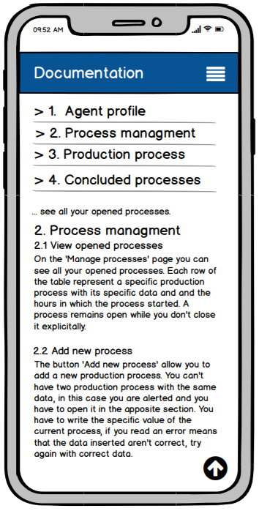
2° prototype - Mockups

Slide 22
Think Aloud
GOAL | DESCRIPTION OF INCIDENT | HOW THE INCIDENT WAS FOUND | POTENTIAL SOLUTION
View previous surveys | The user doesn’t easily understand how he can view the previous surveys: “How can I see the previous surveys?” | In the surveys interface, if the user wants to view the previous surveys, he doesn’t find an explicit indication to carry out the operation and he remains blocked for a few seconds | The addition of an explicit indication to view the previous surveys
View options (Conclude process, notify a problem, delete process) | The user doesn’t easily understand how he can view the process option, for example, to conclude the current process: "How can I conclude the current process?" | In the production process interface, if the user wants to view the options, for example, to conclude the current process, he doesn’t find an explicit indication to carry out the operation and he remains blocked for a few seconds | The addition of an explicit indication to view the process options

Slide 23
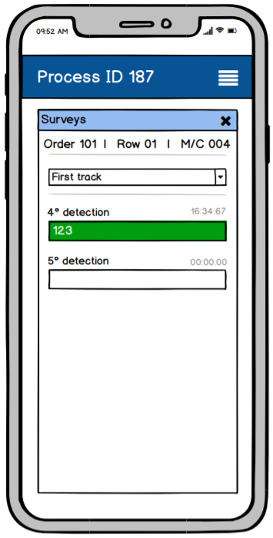
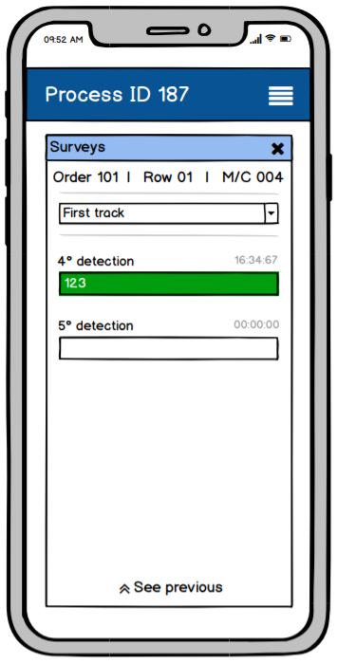

1° Controlled experiment
Task: View the previous surveys
Participants: 7 agents
Independent variables: Interface layout, Previous and Proposal
Dependent variables: Time required to execute the task
My hypothesis: The proposal interface layout reduce the time to perform the task
Null hypothesis: There aren’t differences between the two layout interfaces
Analysis of data
Having F>Fcrit (28.7808>4.7472) the null hypothesis can be rejected. Considering the time average A(prev)>A(prop) (15>8,28) the proposal layout reduces the time to perform the task.
PREVIOUS
PROPOSAL

Slide 24
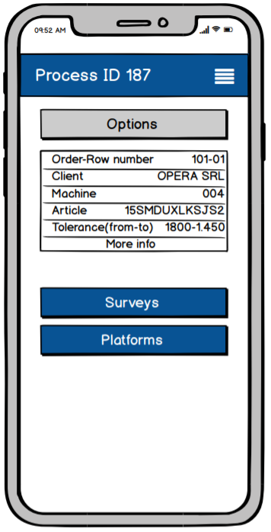

2° Controlled experiment
Task: Find the process options
Participants: 7 agents
Independent variables: Interface layout, Previous and Proposal
Dependent variables: Time required to execute the task
My hypothesis: The proposal interface layout reduce the time to perform the task
Null hypothesis: There aren’t differences between the two layout interfaces
Analysis of data
Having F>Fcrit (17.3028>4.7472) the null hypothesis can be rejected. Considering the time average A(prev)>A(prop) (36>18,85) the proposal layout reduces the time to perform the task.
PREVIOUS
PROPOSAL

Slide 25
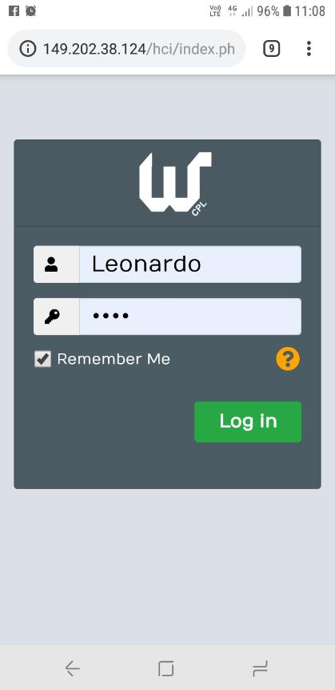
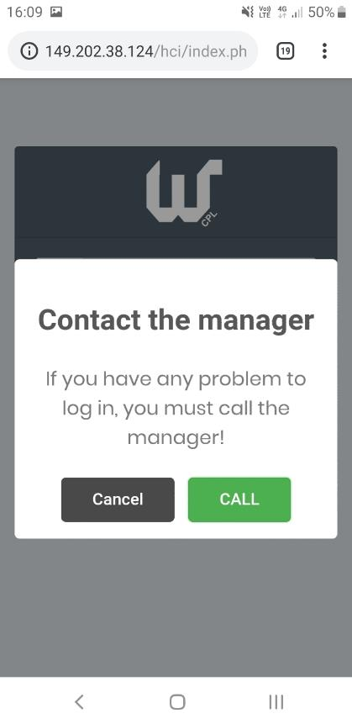
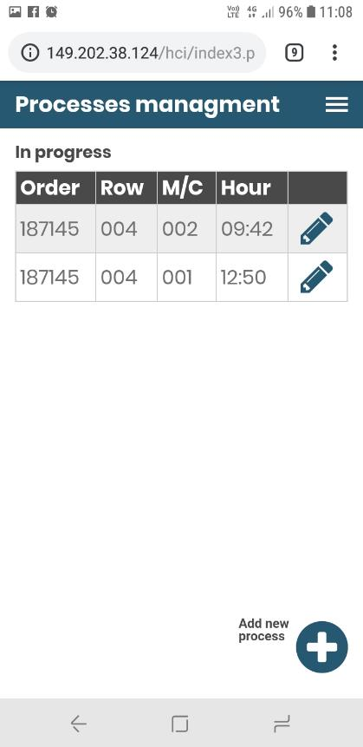
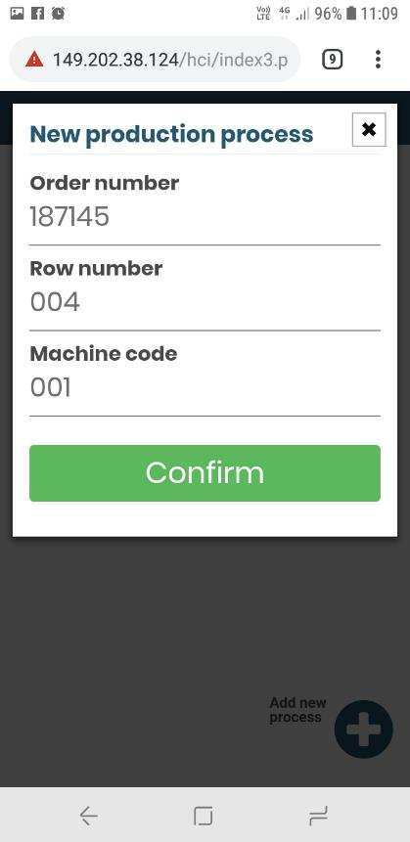
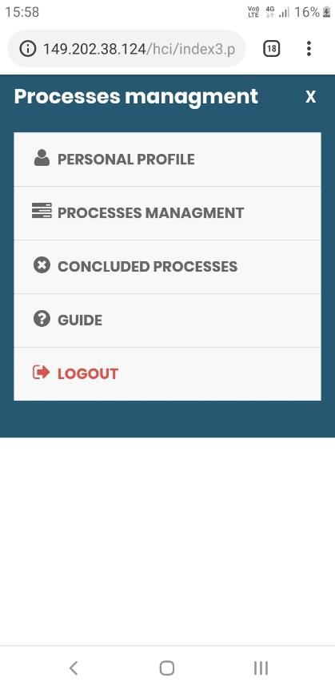
Final product

Slide 26
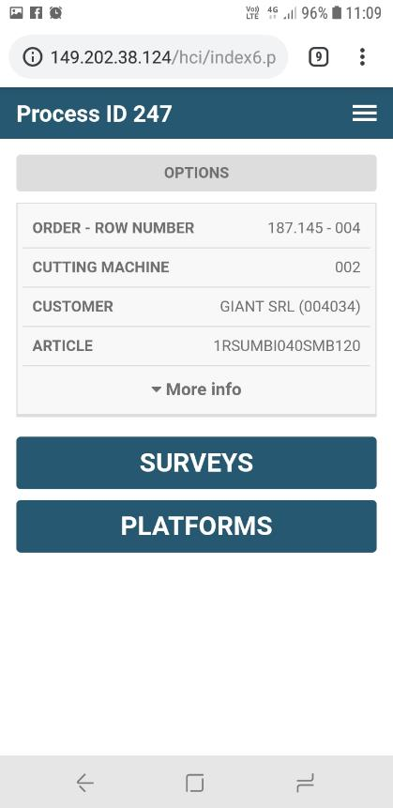
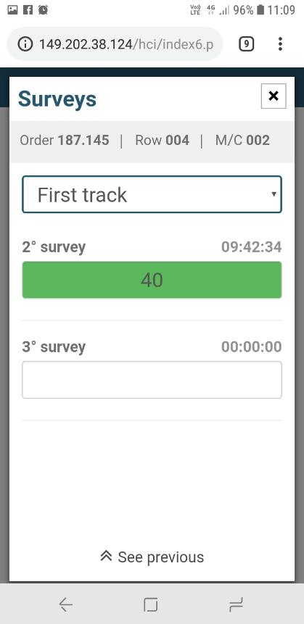
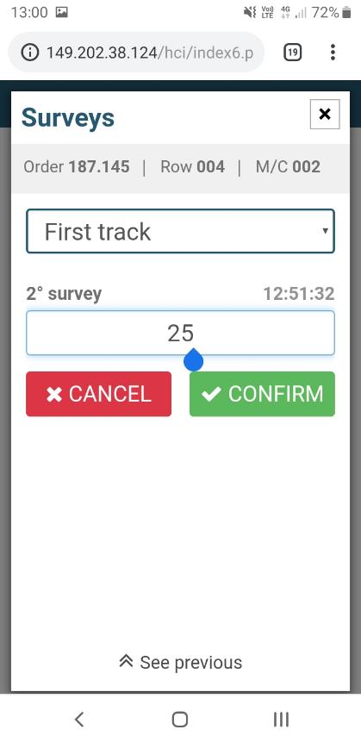
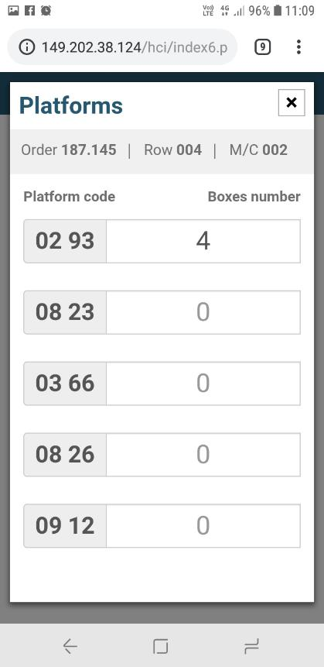
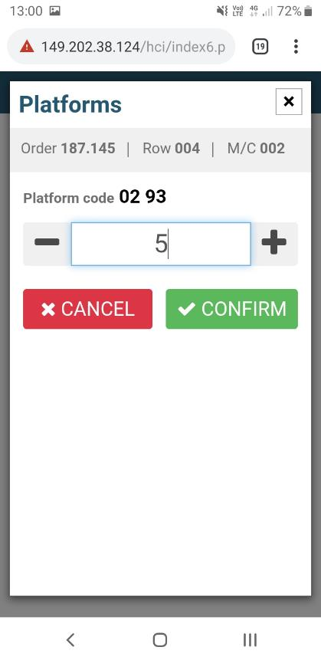
Final product

Slide 27
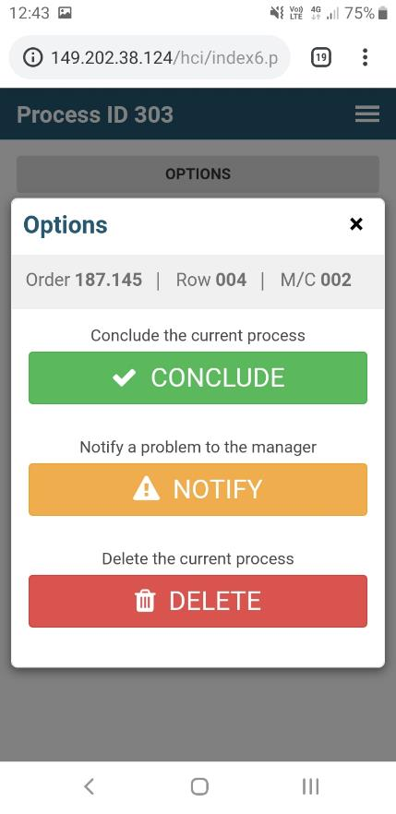
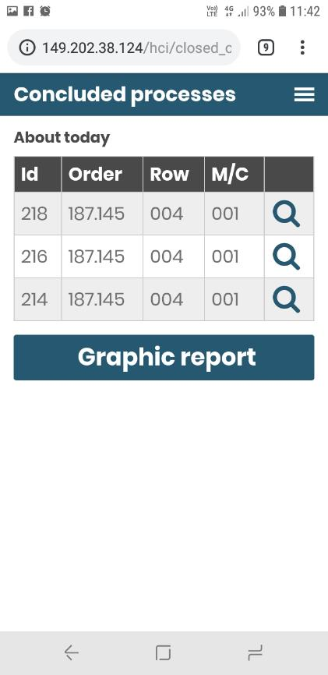
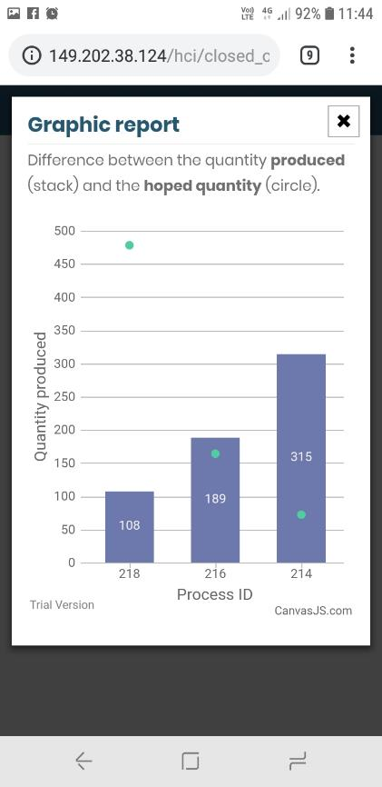
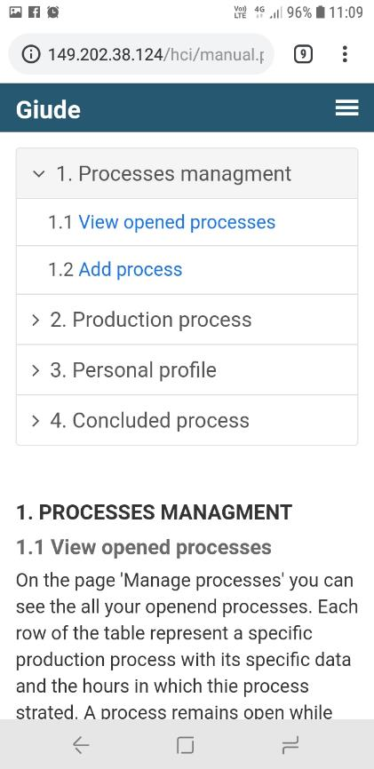
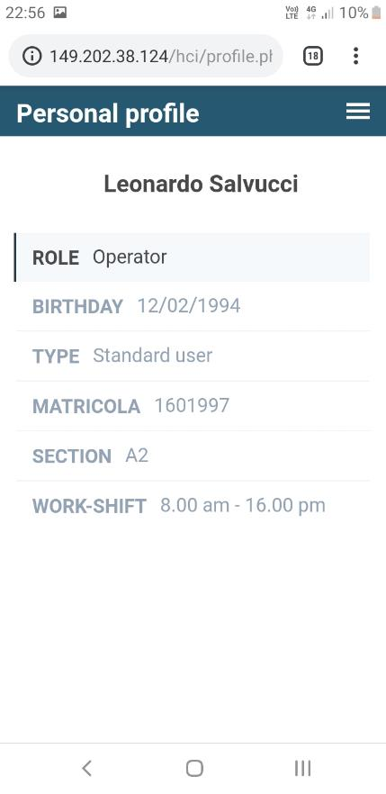
Final product

Slide 28
Future work
01
Adding new production processes
02
Qr code reader
Addition of other types of processes with several phases
Integration of the QR code reader to identify machines, platforms, etc.
03
Differentiation of privileges
04
Interface design
Adding automatic filters based on the user's privileges
Graphics updates based on subsequent changes and new analyzes

Slide 29
Thank you for the attention
WinWork

